Slide 1



Mastering the Customer Journey 2022
Data before and during Covid-19
EMEA Poll - To better understand how customers has acted under Covid–19 and what is expected in the future
How do we use this insight to master the customer journey and how do we get started
Thomas Thorning
Business Solutions Manager - EMEA
thomas-thorning-guldborg

Slide 2















A digital minute in 2020
300.000
STATUS UPDATES
3.8 M
SEARCHES
500.000
Tweets
1.400
Posts
13 M
TEXT messages
4 M
Video Plays
50.000
photos uploaded
2 M
SNAPS
200.000
CALLS
800.000
files uploaded
750.000
SONG STREAMS
100.000
hours of video
7.000
USER MATCHES
700.000
VIDEO PLAYS
www.socialmediatoday.com

Slide 3


Background
EMEA Consumer Poll 2021
In September 2020 SAS launched the first CX 2030 Covid-19 consumer poll across EMEA
2030
This is the new updated version
Key findings across these topics:
  New digital users since the pandemic started
  What do customers really think about the customer experience?
  The most important factors to drive the customer Experience
  Customer loyalty are easily lost

Slide 4
Industry-specific takeaways
Grocery & Food Companies saw the highest rise in new digital users, with an uptake of
Banking & finance has the higher percentage of overall digital users at
20%
55%

Slide 5
What do customers really think about the customer experience
18%
80%
32%
The number of digital users has grown by 18% since the pandemic started.
…of people feel the customer experience has improved during the pandemic.
…of people are more likely to share their personal data now than before the pandemic started

Slide 6
Importance of low prices continues to fall
Price remains the main driver, with 52% including it as a top 3 priority.
48%
42%
43%
Convenience
Good service / CX
For companies that act fairly and responsibly

Slide 7
Customer loyalty are easily lost
48%
52%
of customers would ditch brands after just one or two bad experiences
of customers have switched providers during the pandemic

Slide 8


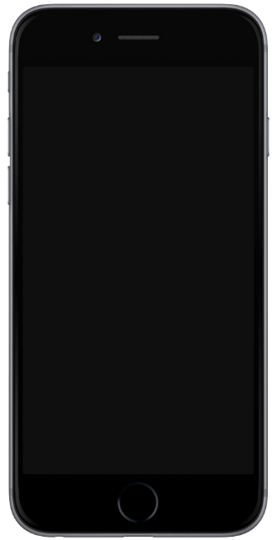
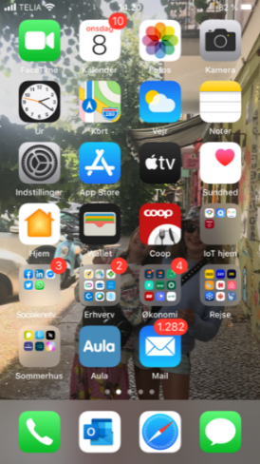
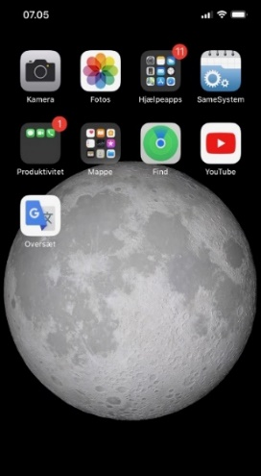
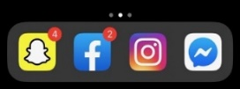
The future customer engagement to the right generation in the right channel
Thomas
Gen X
Emily
Gen Z
GEN Z
Millennial
GEN X
Born Between
1995 - 2015
Born Between
1980 - 1994
Born Between
1965 - 1979

Slide 9

Loyal customers want to be recognized
Walk, Run,……
Fly?

Slide 10
Data Alone Doesn’t Drive Your Organization…. Decisions Do
Operationalizing Analytics
Data
Analytical Insight
Decisions
Impact
Analytically Driven Decisions are Better

Slide 11
Customer engagement capabilities
LISTEN

Slide 12

Customer engagement capabilities
LISTEN
Whoa, there’s a lot going
on here!
LISTEN

Slide 13
Customer engagement capabilities
UNDERSTAND
+
=
What we already know.
What we understand.
UNDERSTAND
What we’ve learned.

Slide 14
Customer engagement capabilities
What’s our best, next action?
Continue to listen.
Gather more data.
DECIDE
Offer them advice.
DECIDE
Communicate with the customer.
Offer a compliment.
Offer a
kind word.

Slide 15
Customer engagement capabilities
Based on your needs, here’s what we recommend…
ACT
ACT

Slide 16
Customer engagement capabilities
z
MEASURE
Aha! We can make this even better.

Slide 17
Customer engagement capabilities
Based on what we’ve learned, let’s take
this approach.
PLAN

Slide 18

Slice the elephant
Modularity in SAS® marketing solution
Get the key insight from your customers
What are the customers really looking for
Make the right interaction in real time and act in the right channel
FUTURE STATE:
ADVANCE ANALYTICS

Slide 19
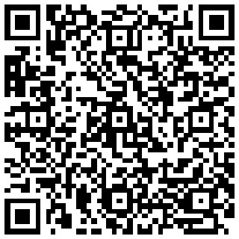
Let’s connect
Thomas Thorning
Business Solutions Manager - EMEA
thomas-thorning-guldborg
Download the EMEA Consumer Poll 2021 here.

Slide 20
Questions
SAS.com

