Slide 1
Loyalty
=
The result of constant positive emotional relationship, and perceived value of every interaction between you and your customers Every interaction means mastering Customer Experience.

Slide 2
Loyalty = brand x value proposal x customer interactions
Customer Experience
Value proposal
Brand
Customer Interactions

Slide 3
Why should we care about loyalty?
Improve customer
experiences
Strengthen brand
Increase revenues
Decrease costs
Reduce churn
Drives customer lifetime value

Slide 4
What is the New Era of Loyalty Marketing? Real loyalty is not bought Data-driven and digital customer experiences that assure that you improve real customer loyalty.

Slide 5
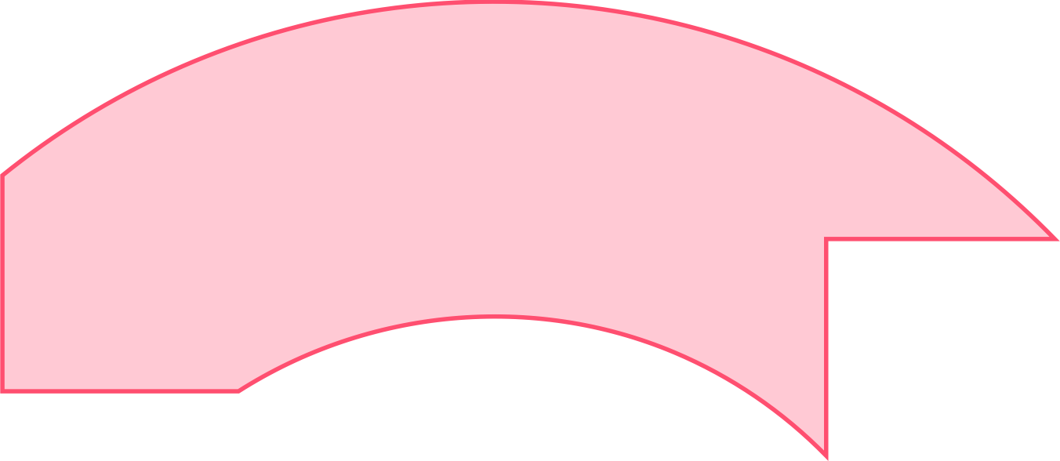
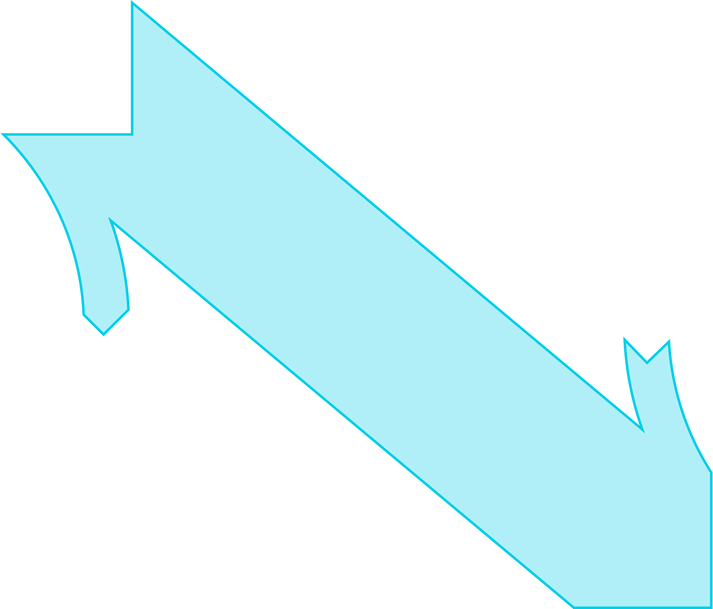
The Customer Life Cycle approach is a key concept when striving to reach excellent customer experiences and improved loyalty
Customer attraction
Customer aquisition
Customer development
NEW
CUSTOMERS
EXISTING
CUSTOMERS

Slide 6
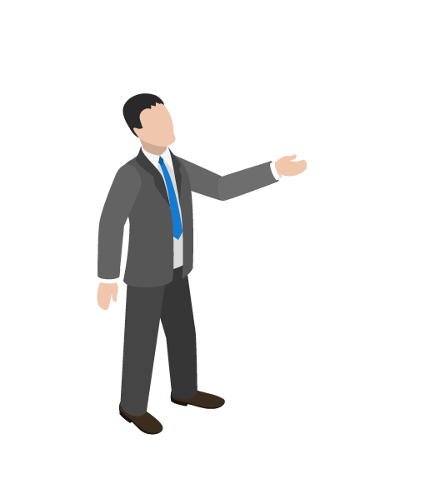
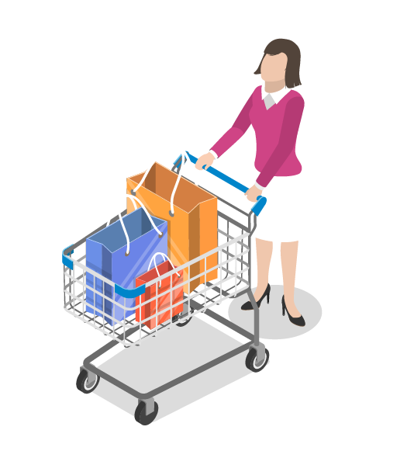
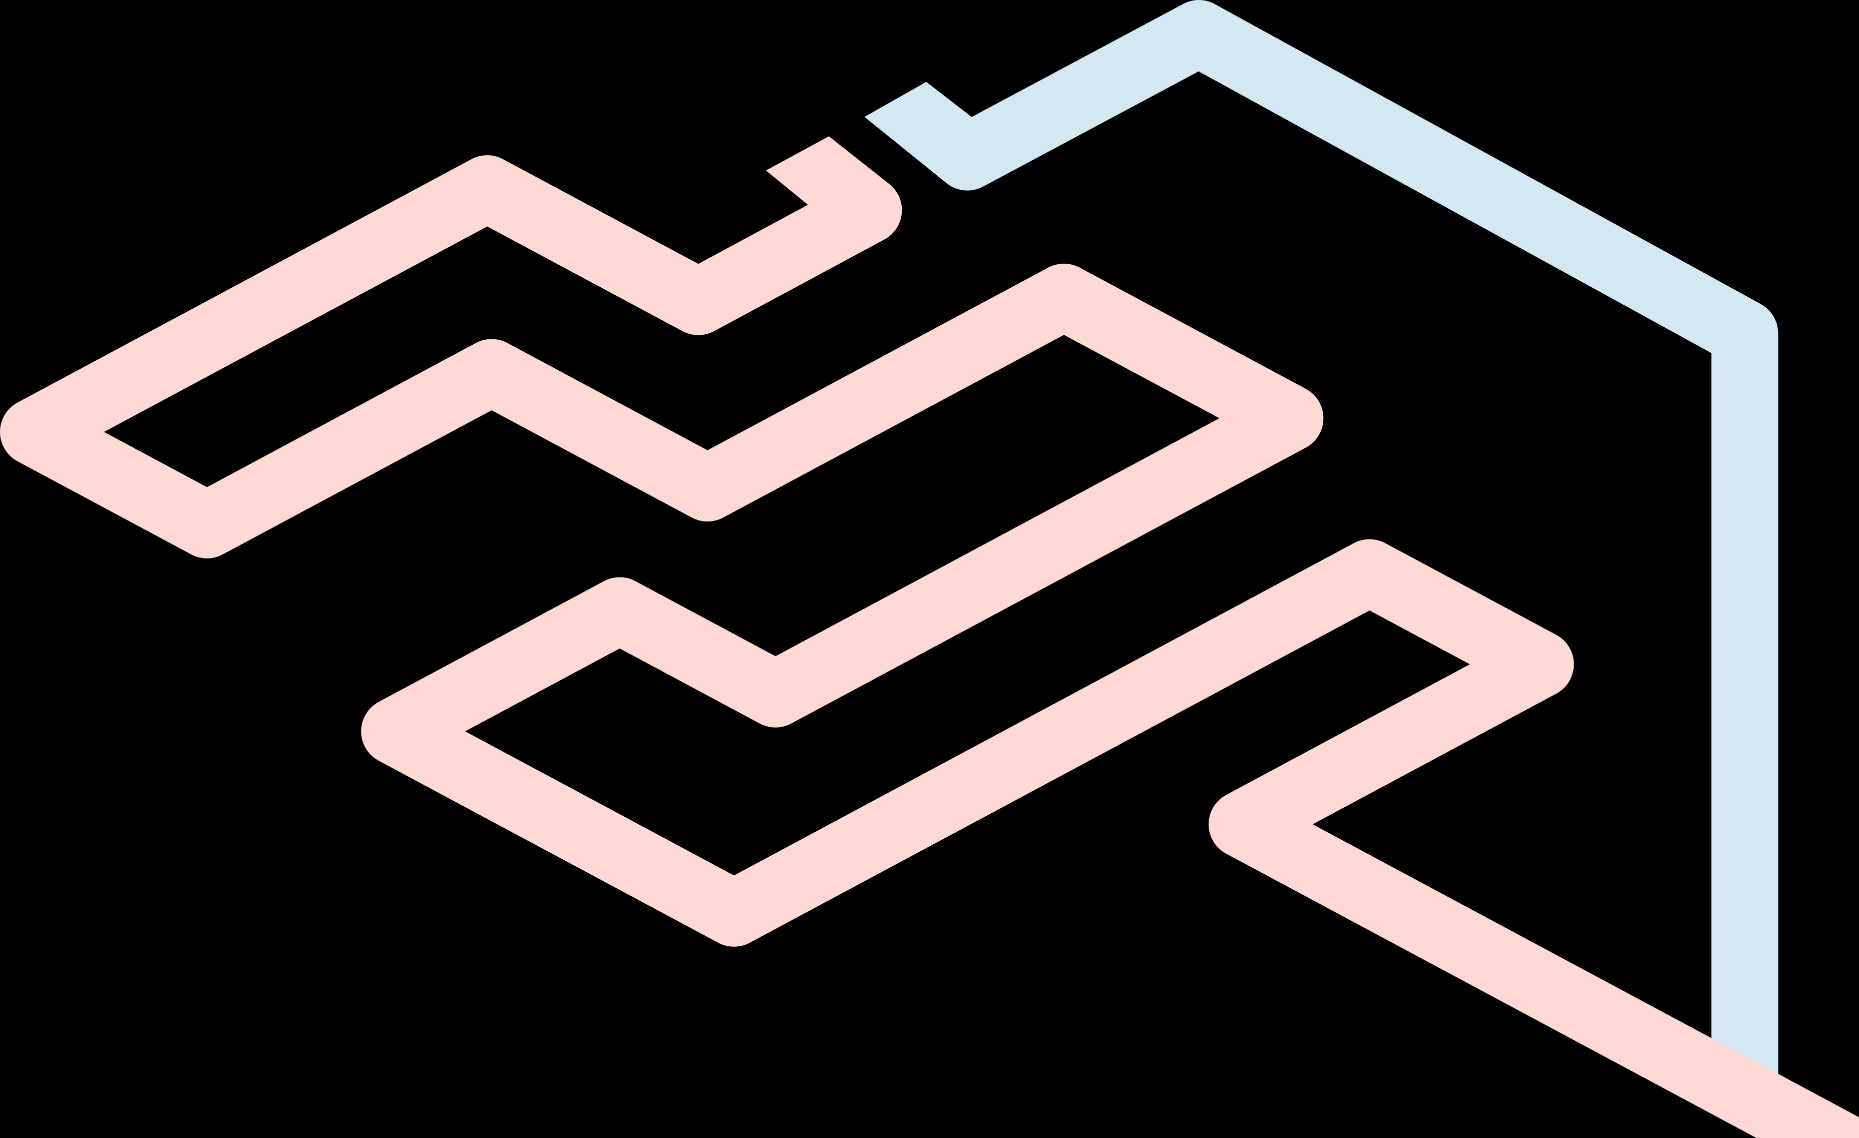
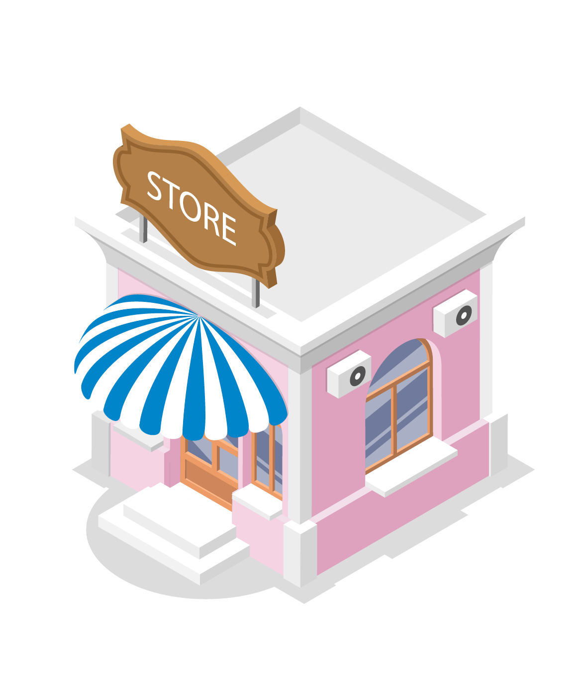
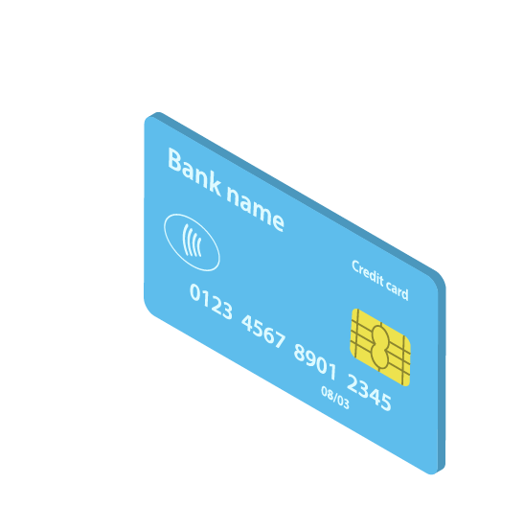
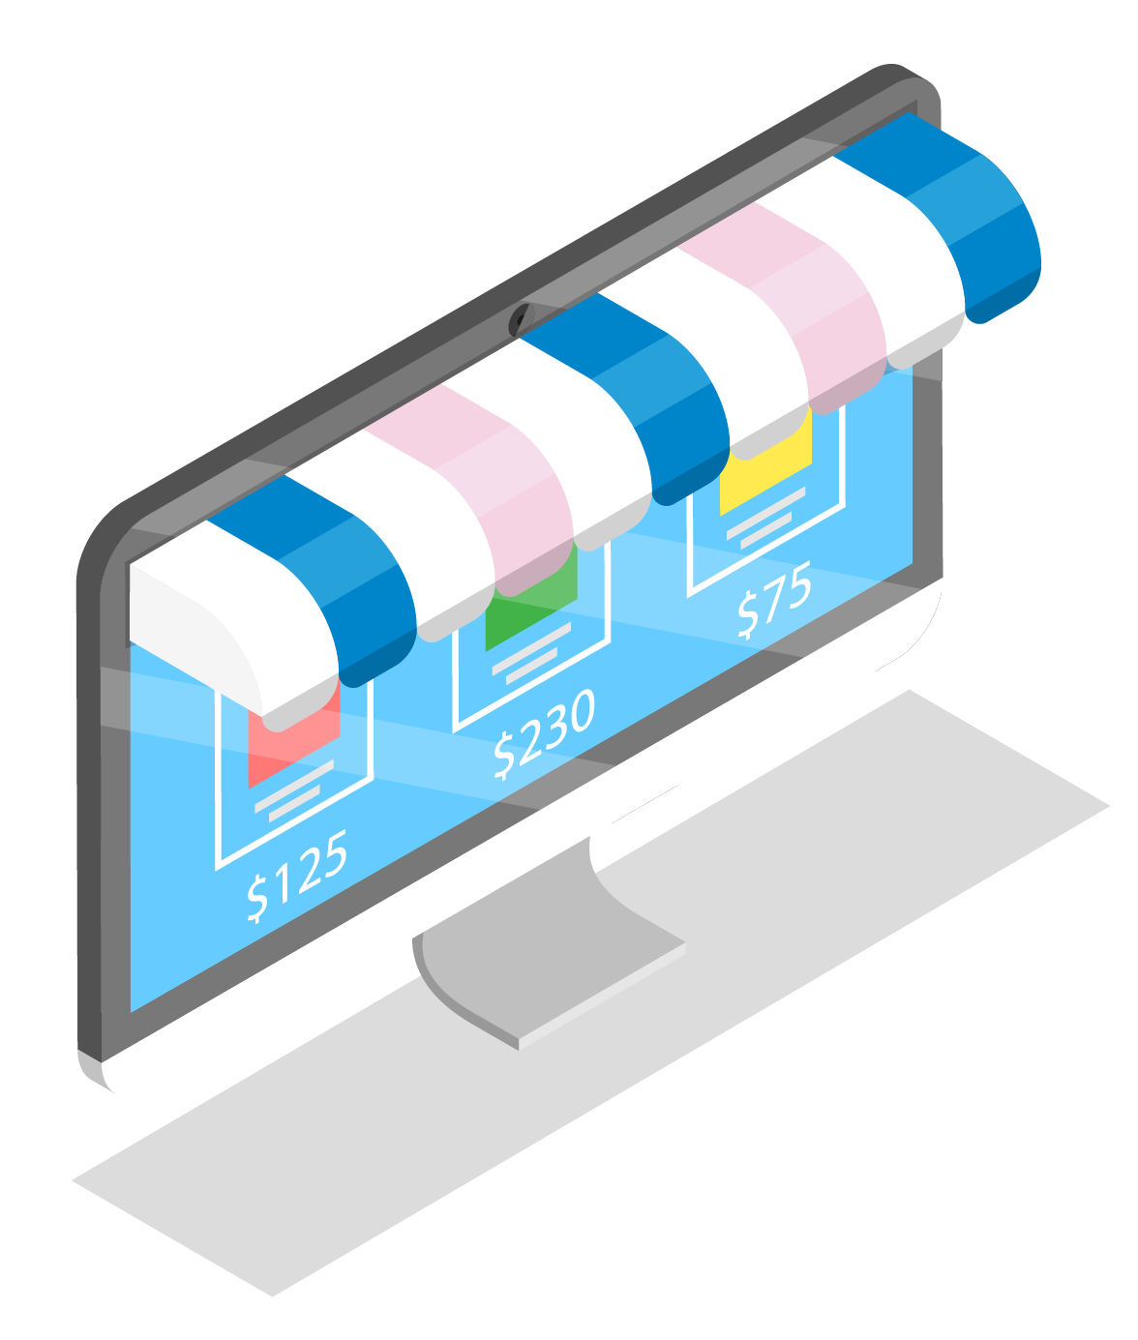
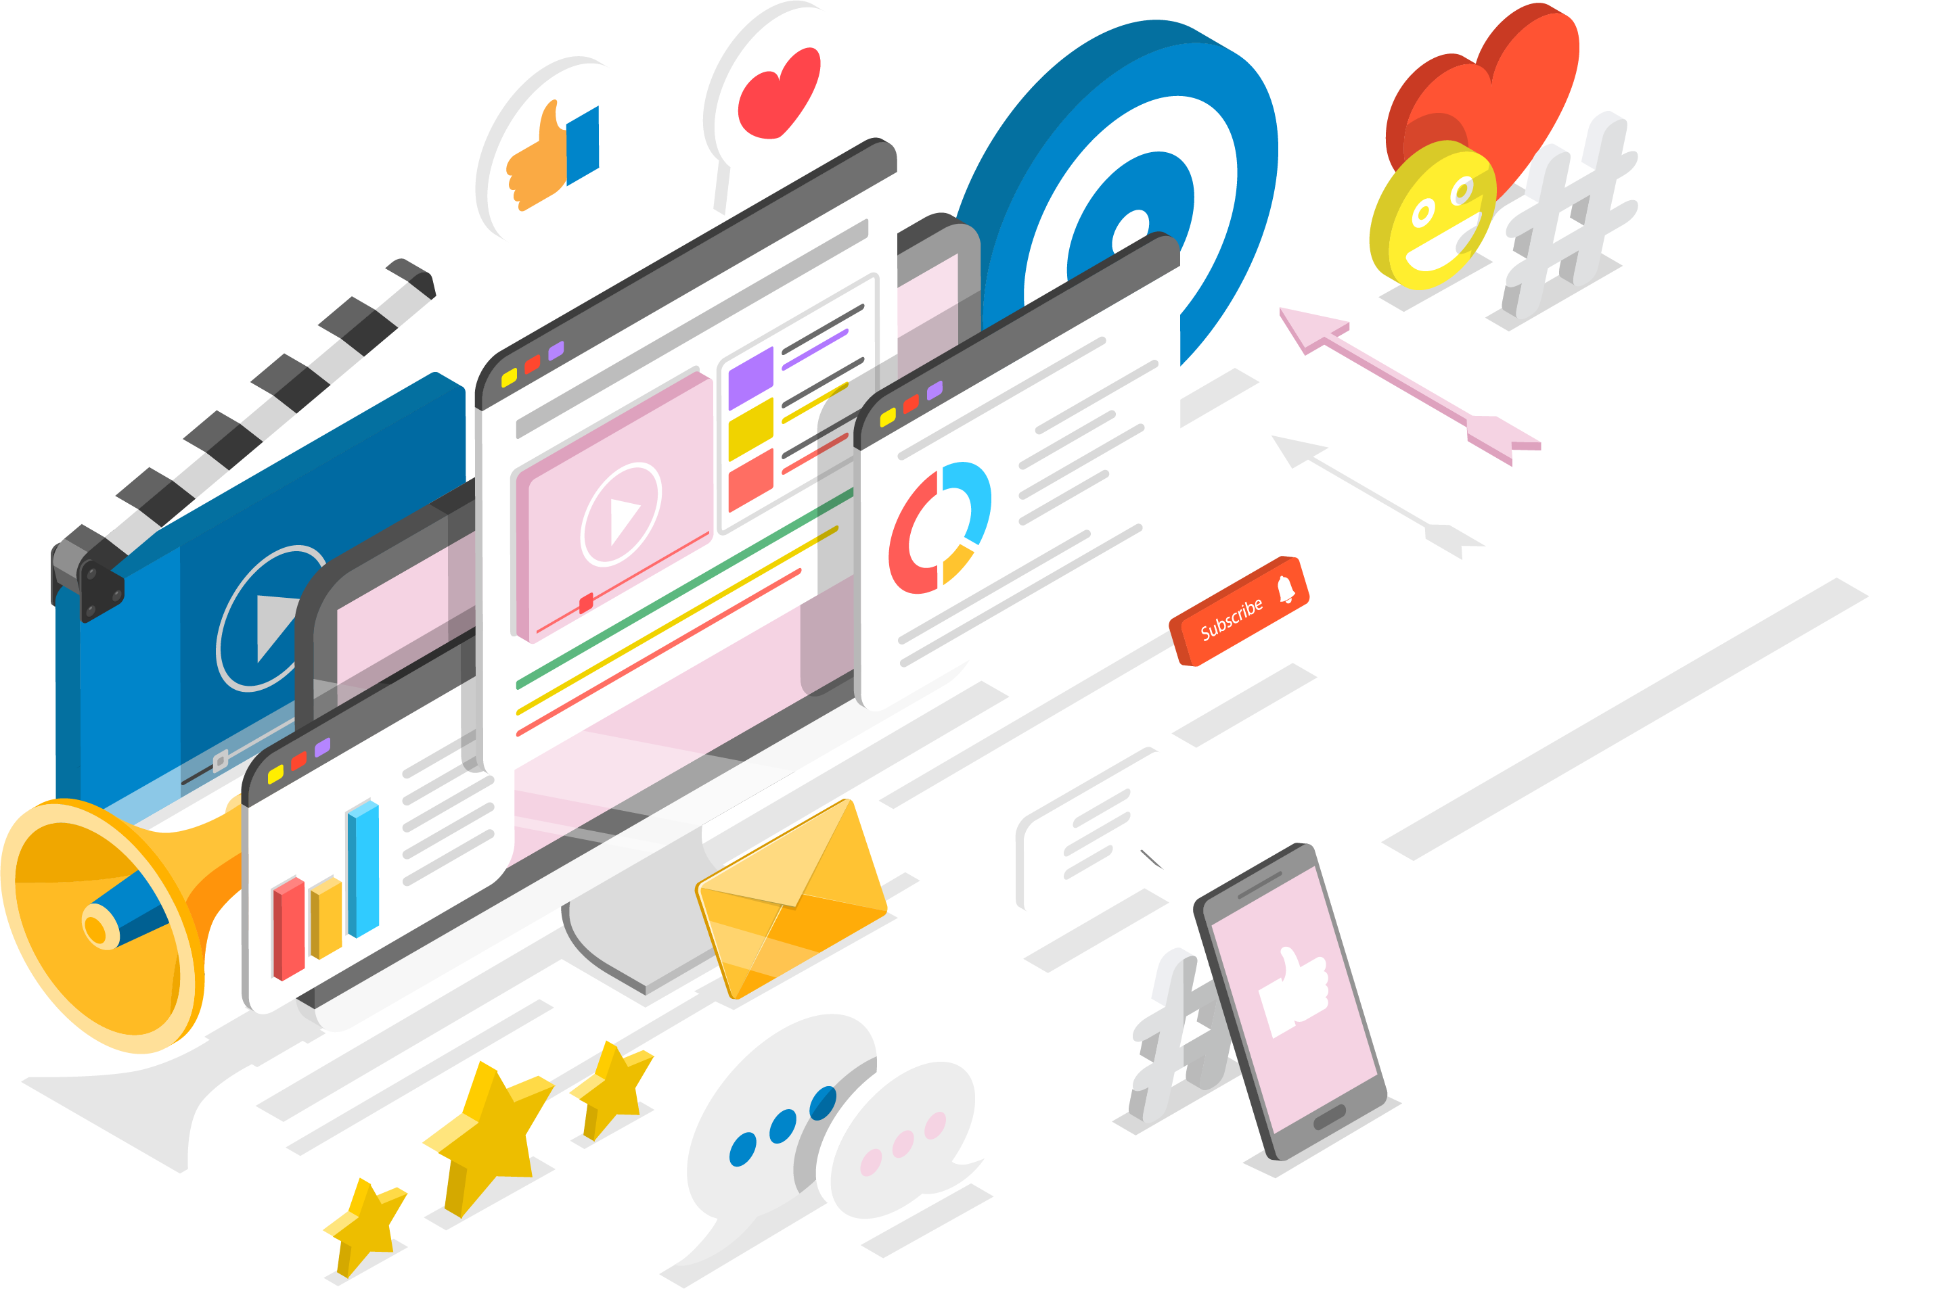
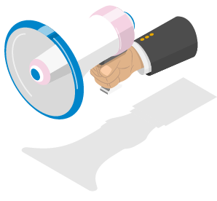
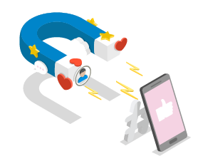

Slide 7
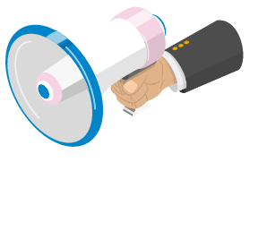
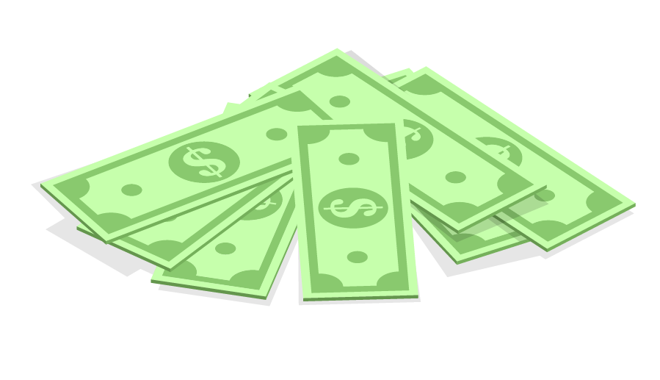
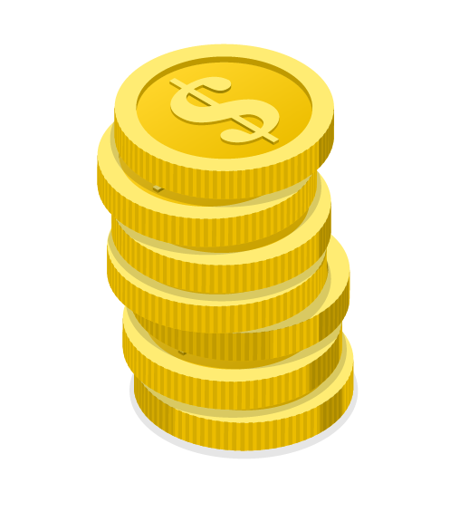
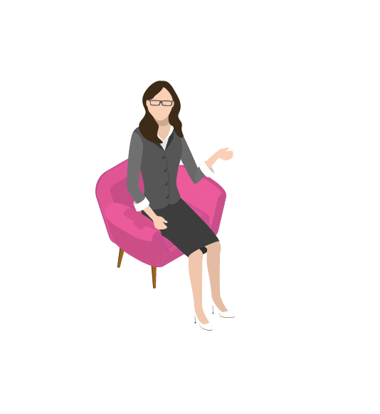
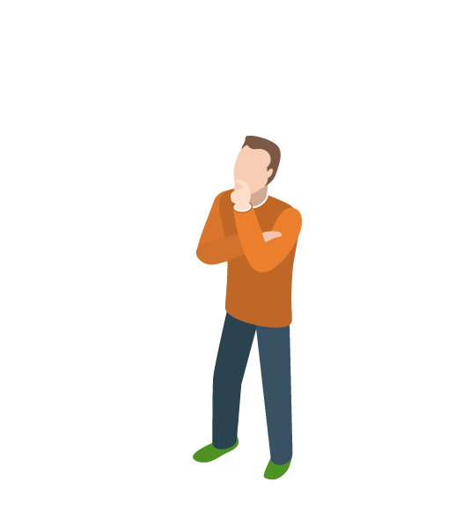
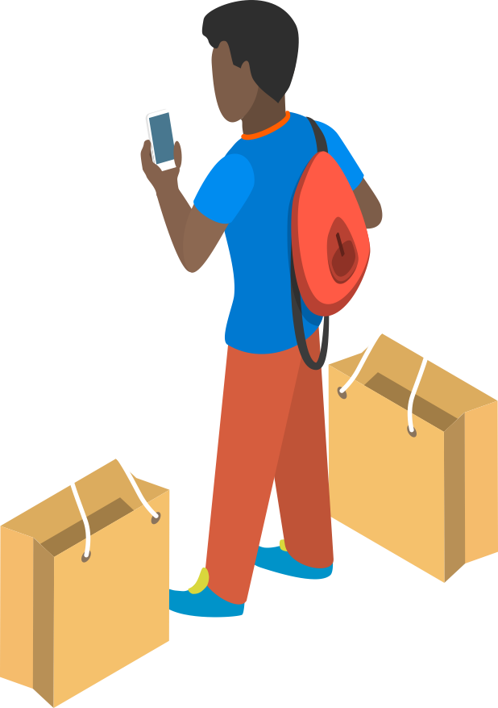
Conversion
Maintain
Conversion
Expand
Conversion
LOYALTY TEAM
BRAND/DIGITAL PERFORMANCE TEAM
Marketing and communication strategy
Channel strategy
Data Strategy
Organization and WoW

Slide 8
Data and digital tools must support dialogues in the entire customer life cycle
Awareness
VIP bought 5+ times for x amount
Product segment x, 5+ times for x amount
Highest CLV
Predictive - most likely to be a customer within 1 year
Consideration
Conversion
Maintain
Ad data
Web data
Purchase data
Customer data
Response data
Expand

Slide 9
Customer loyalty is much more than customer satisfaction - genuine relations will need to be established
Customer Loyalty
”I am very satisfied and I like everything the company stands for”
All interactions are relevant
Customer Preference
”I am satisfiued with the product/service and I like the company”
Customer Satisfaction
”I am satisfied with the product/service”
Expectations are met

Slide 10
Successful loyalty requires customer data and the right marketing mechanisms
Customer base
Attitude loyalty
Win in every interaction
Stable Upsell and loyalize further
High degree of churn
Will lead to churn over time
Transactional
loyalty

Slide 11
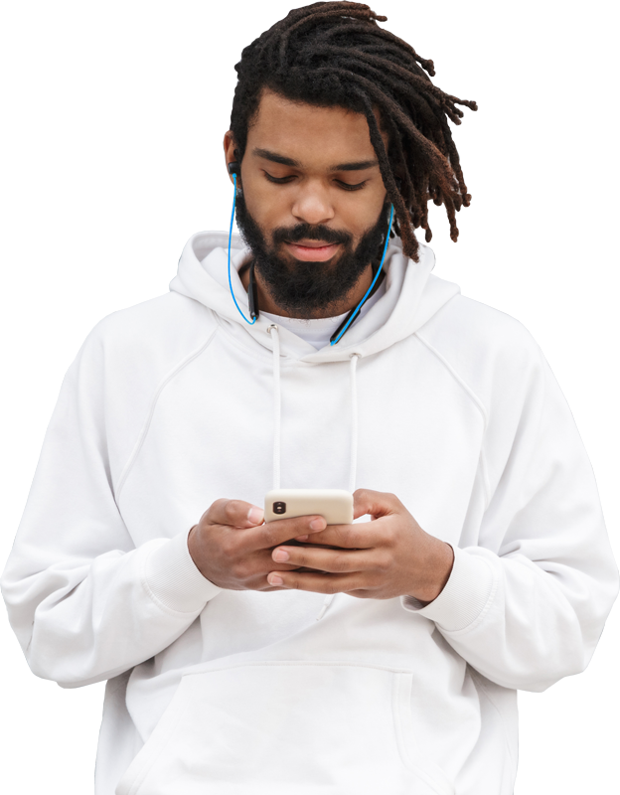
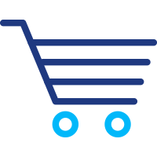
Selligent Marketing Cloud enables targeted campaigns and 1-2-1 dialogues based upon insights
SMS
DM
Email
Some key features are:
Live content
Smart Content
Smart Audience
Send Time Optimization
Web
In-Store
Universal Profile
Foundation and intelligence layer
Call
Social
Push
Cortex
Real-time decisioning
Consumer Intelligence
Analyze consumer behavior
Site
Personalized web experiences

Slide 12
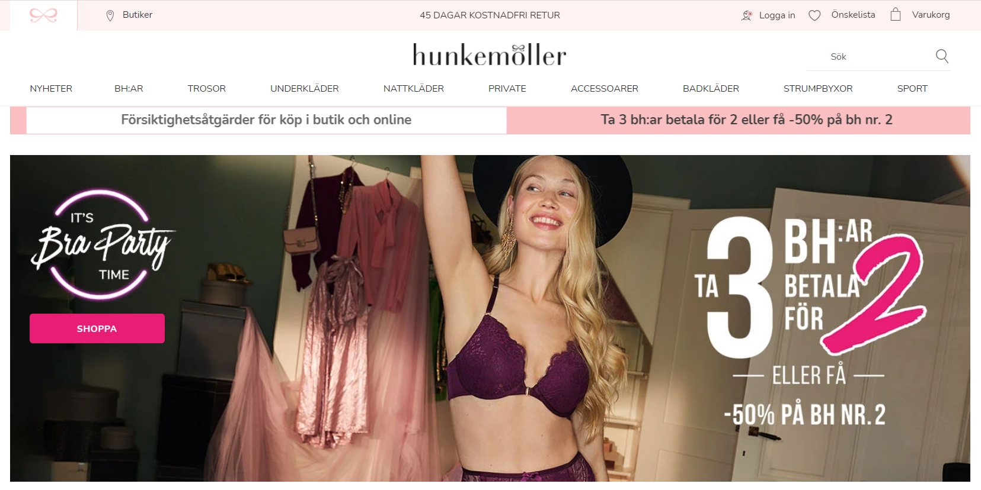
Selligent Marketing Cloud – Hunkemoller Case Study Underneath the underwear

Slide 13
Your ability to understand and react is critical
Maturity curve for your loyalty work
Customer insights, i.e. ability to understand
Improved accuracy in marketing activities
Real time personalization
Confirm
Acknowledge
Identify
One-to-one loyalty
Segment specific loyalty approach
Traditional loyalty scheme
Monthly
Bi-weekly
Weekly
Immediately
Customer experience i.e. abitity to react

Slide 14
A new era for loyalty marketing – to summarize
How should loyalty be created in the new era?
Every interaction matters
Customer satisfaction is not enough
Targeted and personalized dialogues
Create abilities to understand customer insights
Create abilities to react; digital tools

Slide 15
Thank you!

