Slide 1
Any time, anywhere customer service
Deliver effortless, cross-channel delight to the modern shopper
6 november 2021

Slide 2
Recent recognition for our work
Magic Quadrant Visionary
CRM Customer Engagement Center, 2020, 2021
CRM Lead Management, 2020
Sales Force Automation, 2020
IT Service Management Tools, 2020
Social Media Customer Service
2021
Forrester Wave
Chatbots for IT Operations, 2020
Best Overall CRM Company
2020, 2021
4x Cloud 100 Winner Ranked Ranked #10 in 2021

Slide 3
Delight made easy
Customer Solutions (CRM)
Employee Solutions
Customer Experience
Sales
Marketing
IT Management
HR Management
Omnichannel Suite
Support
Desk
Freshsales Suite
Freshmarketer
Freshservice
Freshteam
Messaging
Contact Center
Freshsales
Customer Success
Platform

Slide 4
An AI-powered, omnichannel, customer service platform for intuitive, personalized, and collaborative customer service.
Delight your customers with effortless omnichannel service.
Engage in more meaningful conversations every day, across every channel, with every customer.
462% ROI realized by customers in 3 years
27% lower ticket volumes due to self-service and AI-chatbots
2.9M in savings and 38% fewer phone calls by deploying digital service channels
25% better average handle times due to the intuitive and powerful agent desktop
47 FTEs worth of capacity unlocked due to improved operations

Slide 6
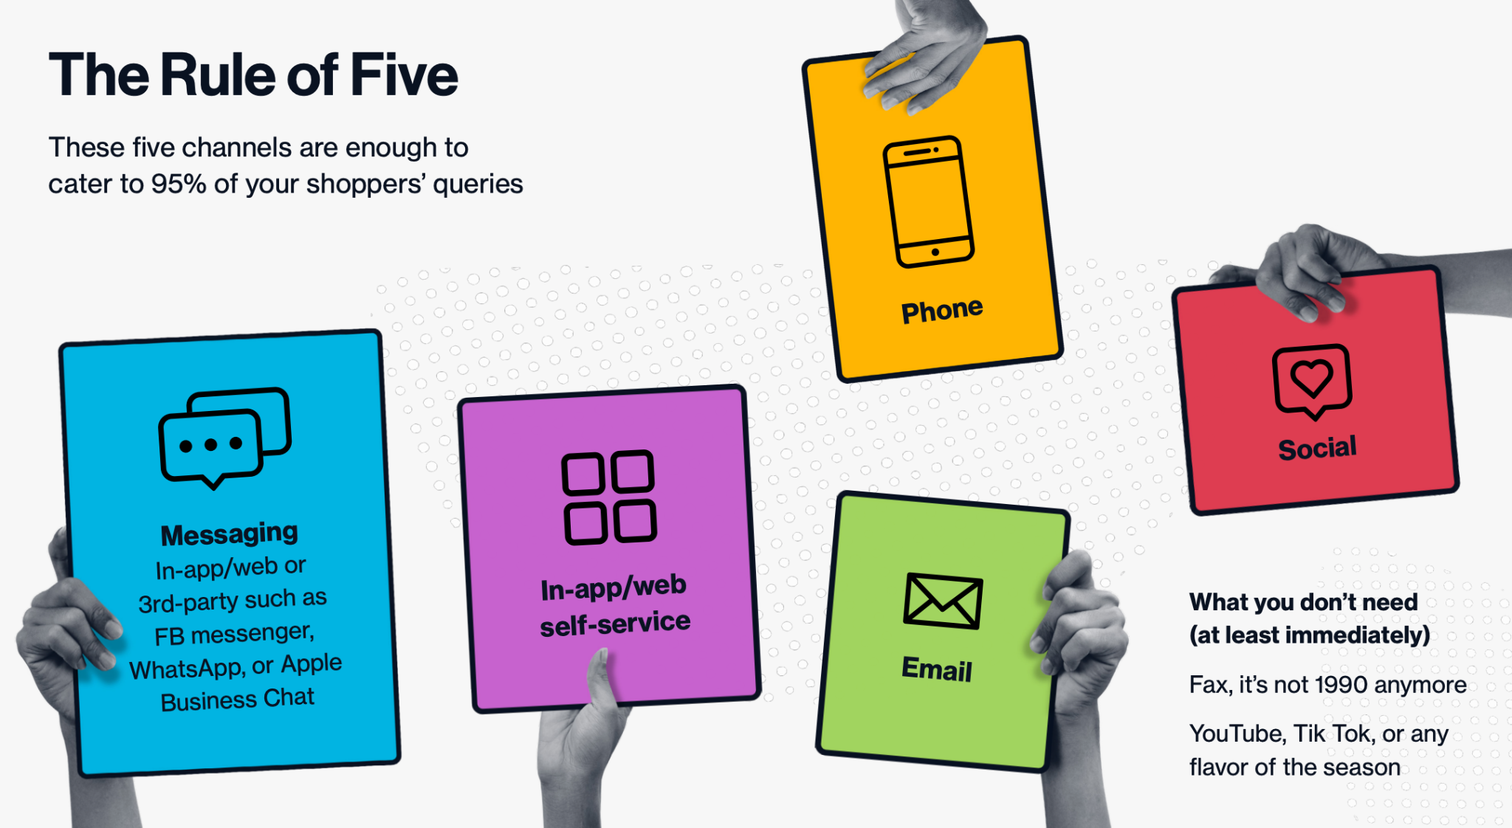

Slide 7
Why Self-service?
Why Email?
Why Social Support?
Why Messaging?
Why Phone?

Slide 8
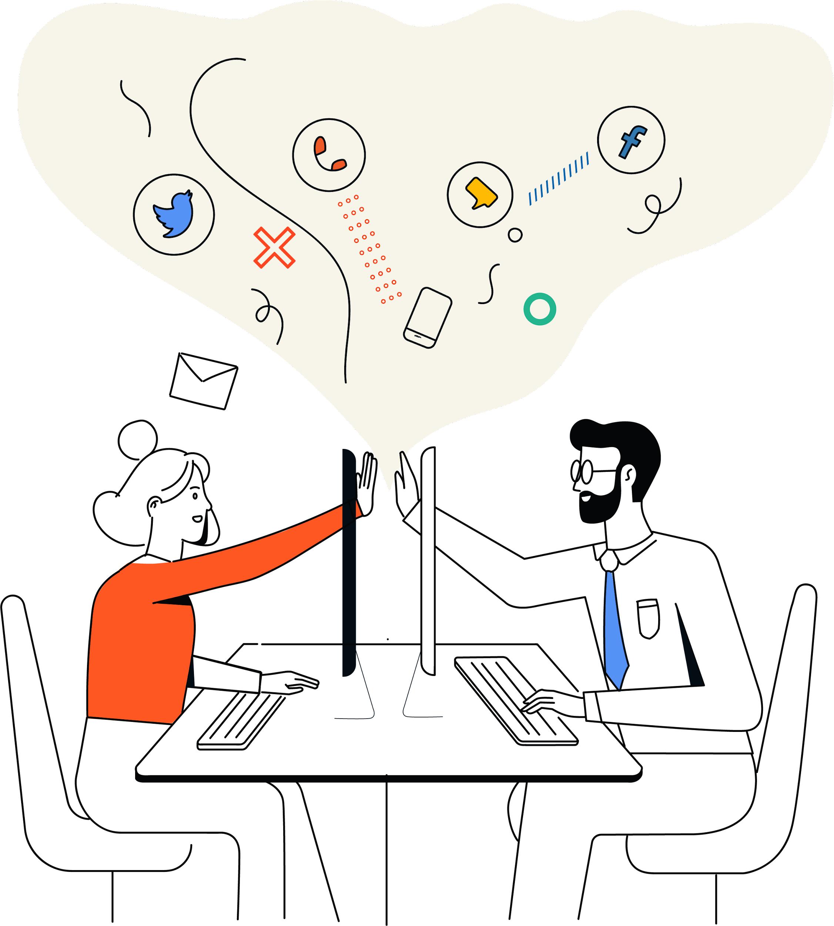

Slide 9
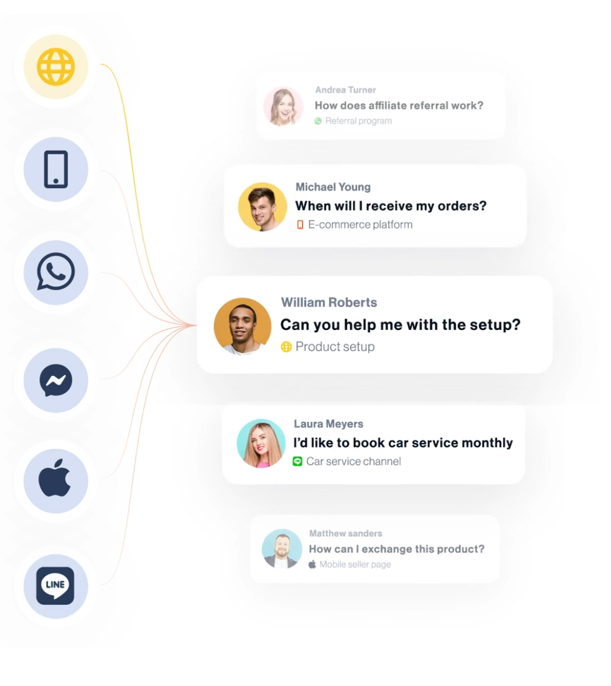
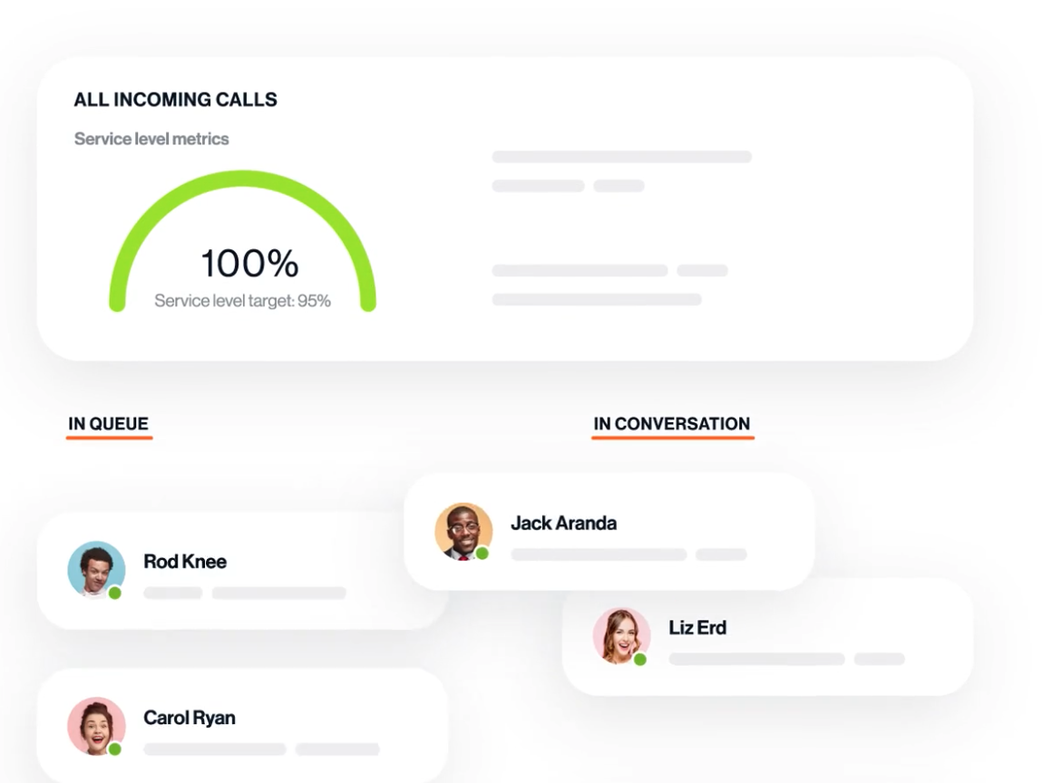

Slide 10
Engagement Model

Slide 11
What else?
Overview learnings during this implementation
Next steps

Slide 12
Thank
you!

