Slide 1
From CRM to Customer Engagement – Powered by Agile

Slide 2
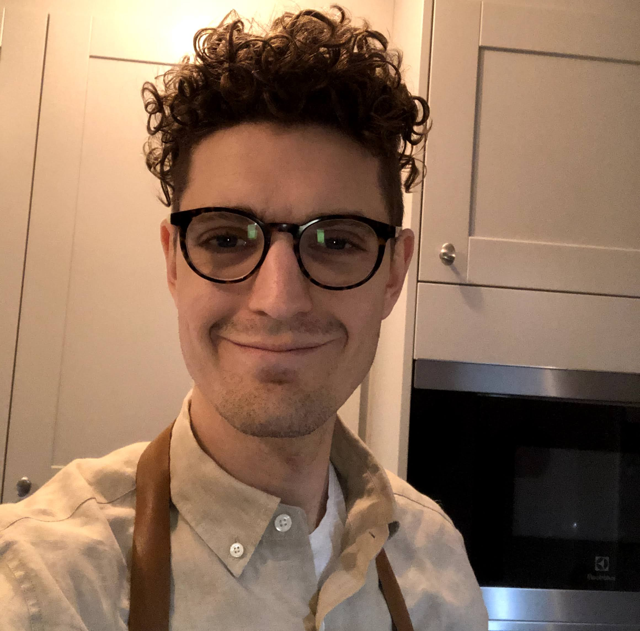
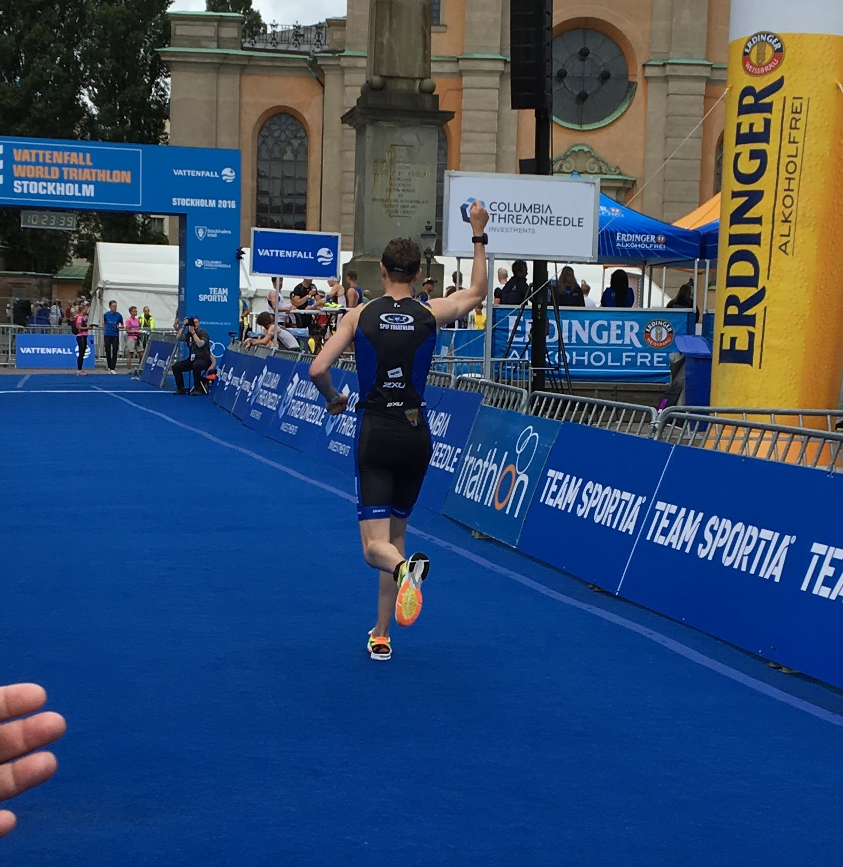
Richard Meurlin
Marketing Owner, Customer Engagement
Former triathlet och CRM Manager
linkedin.com/in/richardmeurlin/

Slide 3

We exist to democratise savings and investments.

Slide 4
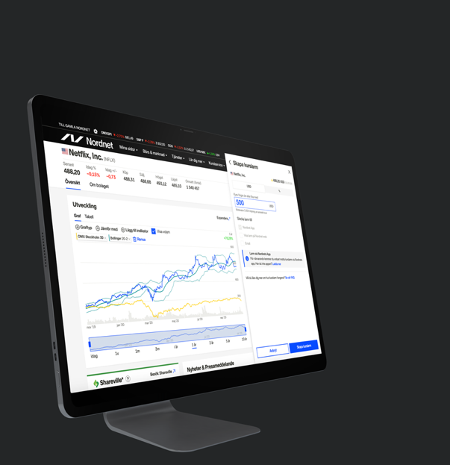
Building the best platform for savings and investments.

Slide 5

Making communication a Unique Selling
Point for Nordnet.

Slide 6

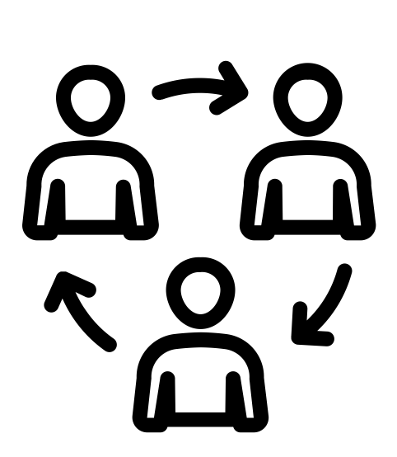

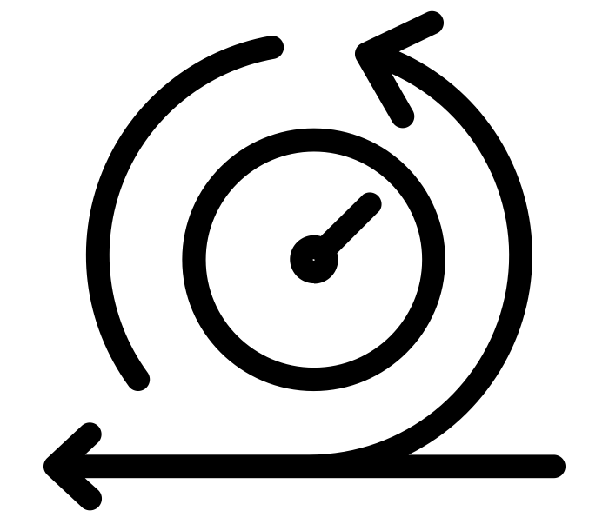
What we need to deliver
Structure through prioritization and a reliable heartbeat.
Speed with a dedicated team with a clear framework for collaboration.
Quality trough tight collaboration cross competencies.
Test and learn with an iterative process.

Slide 7
Backlog
Task
Task
Task
Task
Task
Task
Task

Slide 8
Heartbeat
Sprint
Week 1
Week 2
Planning
Stand up
Stand up
Stand up
Stand up
Stand up
Stand up
Stand up
Stand up
Retro
Refinment
Review

Slide 9
Scrumboard
To do
Doing
Done
Sub task
Sub task
Sub task
Task
Sub task
Sub task
Task
Sub task

Slide 10
Learning 1
Define the assignment around what you can control.

Slide 11
Learning 2
Don’t compromise with the method

Slide 12
Learning 3
Work in short iterations

Slide 13
Learning 4
Take help and get inspired by those who have done it before

Slide 14
Thanks and good luck!
Richard.meurlin@nordnet.se
linkedin.com/in/richardmeurlin/

